Slide 1
Graph Isomorphism Problem : Status and Perspective
By-
Rithin Manoj
SriCharan Battu

Slide 2
Graph Isomorphism
Two Graphs G(V,E) and H(W,F) are said to be isomorphic if there
is a bijective function f: V → W such that for all u, v in V :
(u,v) ∈ E ⬌ (f(u), f(v)) ∈ F

Slide 3
Graph Isomorphism Problem
Computational Problem of determining if two finite
Graphs are Isomorphic

Slide 4
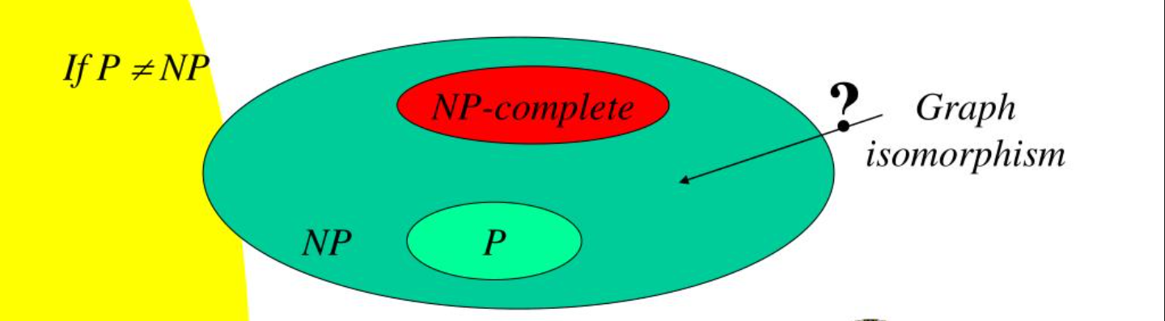
COMPLEXITY
Problem is in NP,but
No NP-completeness proof is known
No polynomial time algorithm is known

Slide 5
ISOMORPHISM-COMPLETE
Problems are isomorphism complete ,if they are ‘equally hard’ as graph isomorphism
Isomorphism complete Problems:-
Isomorphism of Directed Graphs
Isomorphism of bipartite Graphs
Isomorphism of finite automata

Slide 6


HISTORY OF COMPLEXITY
One of Garey and Johnson’s 12 problems unknown to be NP-complete or in P
1980s - runtime -
2015- Babai publishes a quasi-polynomial time algorithm -
2017 -
Harald Helfgott discovers an error resulting in sub exponential time
Babai makes a revision to restore the quasi-polynomial claim

Slide 7
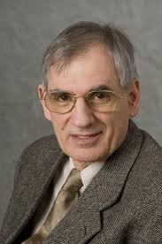
Notable Personalities
Lazlo Babai
Eugene M. Luks : Worked with Babai to create
lowest theoretical bound algorithm(1983)
Laszlo Babai : Created Quasi Polynomial time algorithm(which is being reviewed), involving group theory
and formulations of his own(2015)].
Brendan McKay : Practical algorithm for graph Isomorphism Problem. Software Implementation, NAUTY(a leading tool in graph canonizations)

Slide 8
Properties of Isomorphic Graphs
Isomorphism Invariant : A function f such that
G ≃ H ⇒ f( G ) = f( H )
Complete Isomorphism Invariant : A function f such that
G ≃ H ⇔ f( G ) = f( H )

Slide 9
Properties of Isomorphic graphs
Isomorphic graphs have
Same number of vertices
Same number of edges
Same degree sequence
Same chromatic number, domination number etc.
Same eigen values for their adjacency matrices
Isomorphism invariants but not complete isomorphism invariants

Slide 10
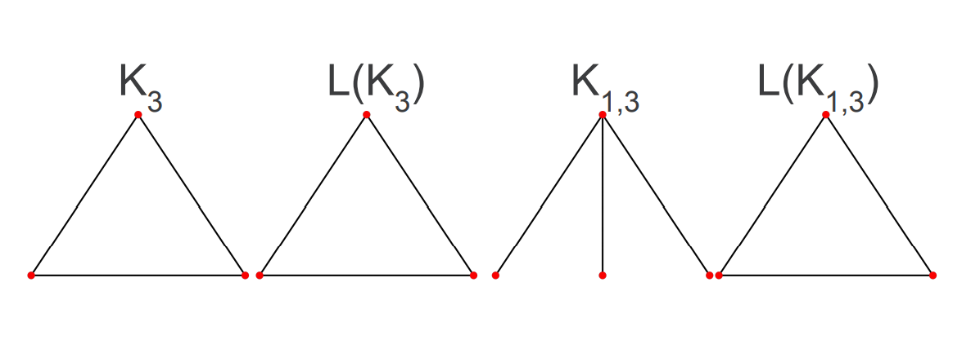
WHITNEY THEOREM
Theorem: Two graphs are isomorphic if and only if their line graphs are isomorphic, with the exceptions of K₃ and K₁,₃

Slide 11
ALGORITHMS

Slide 12
Ullman’s Algorithm
Algorithm for subgraph isomorphism
Find Candidate vertices for each vertex
Refine the candidate list
Description:
Determine a candidate vertex for mapping
Recursively try to map its neighbors using DFS
If a neighbor cannot be mapped we backtrack
O(n!n³ )

Slide 13
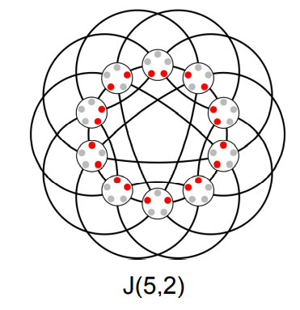
Babai’s Algorithm
Quasi-polynomial time exp(log(n)^O(1))
Divide and conquer strategy
Looks for Johnson graphs

Slide 14
Canonization of Graphs
Graph Canonization is the problem of finding the canonical form a given graph G
Canonization is an operation of placing the vertex labels in a way that does not depend on where they were before
A Canonical form is a labelled graph Canon(G) that is isomorphic to G
The isomorphic graphs have same canonical form and non isomorphic graphs have different canonical forms i.e It is a complete graph isomorphism invariant

Slide 15
Canonization of graphs
The problem of canonization of graphs is at least as computationally hard as graph isomorphism problem
In 1977, Lazlo Babai reported that with probability at least 1-exp(-O(n)),a simple vertex classification algorithm produces a canonical labelling, chosen uniformly from the set of all n-vertex graphs only after two refinement steps
An important breakthrough in probabilistic complexity theory
Sheds some light on why isomorphism related algorithms works well in practice

Slide 16
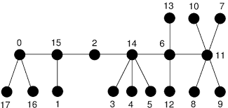
Special Cases : CaterPillar
Compare the degree sequences
of nodes in the spine in the order
of their appearance(two orders:
front to back and back to front)
Algorithmic Complexity : O (|V1|+|V2|)

Slide 17
Special Cases : Rooted Tree
An algorithm called AHU algorithm solves Graph Isomorphism problem for rooted trees in polynomial complexity
Proposed by Aho , Hopcroft , Ullman
If a rooted tree can be solved, a general tree can also be solved
Take centre of the tree as root and proceed

Slide 18
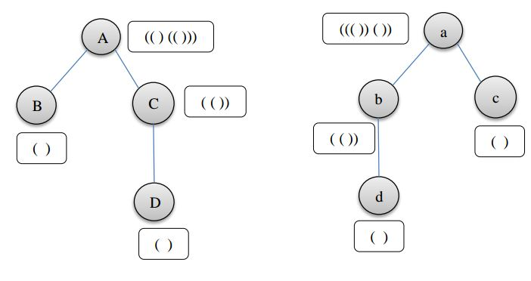
Special Cases : Rooted Tree
AHU Algorithm
Every node is assigned
a sequence of braces
A parent has a sequence
where another set of
braces enclose the sequence
of it’s children after sorting them lexicographically

Slide 19
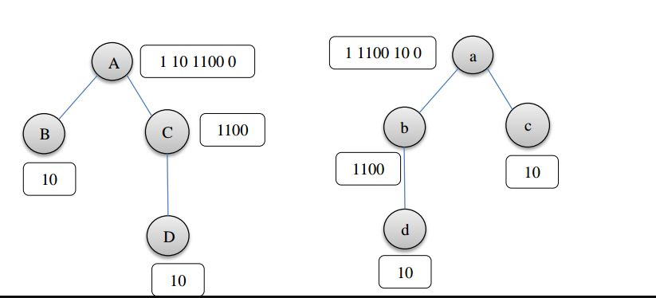
Special Cases : Rooted Tree
Replacing ‘(‘ with 1 and ‘)’
with 0
These sequences are called Knuth
tuples.
Given a Knuth tuple at the root,
A tree can be uniquely constructed.
Given a rooted tree, a Knuth
tuple can be uniquely assigned
(since lexicographically sorted at every node)

Slide 20
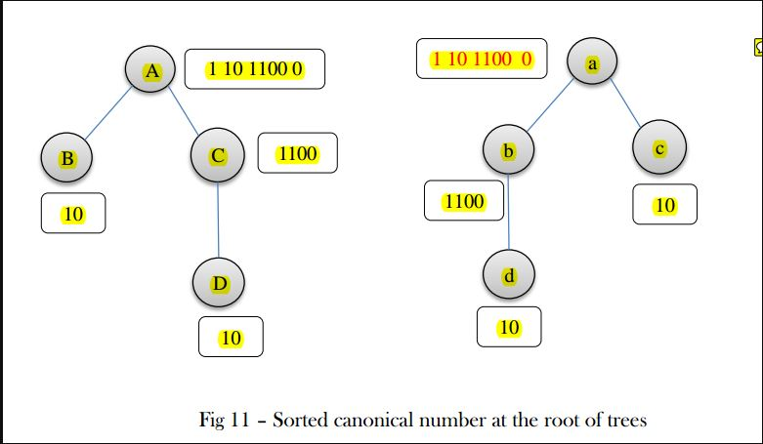
Special Cases : Rooted Tree
Thus for a rooted tree, Knuth tuple is
A complete Isomorphism invariant.
Assign simple Knuth tuples to
the leaves
Then follow a bottom-up approach
Depth-first search is implemented.

Slide 21
Special Cases : Tree
Centre of a tree can have at most 2 nodes and at least 1 node.
If both the given trees have centres with single nodes, make them roots and proceed
If both the given trees have centres with two nodes, Assign one of the two as root for the first tree and implement AHU algorithm twice considering each of the two nodes as root for the second tree
If both have different number of centres, they are not isomorphic(as it is an isomorphism invariant).

Slide 22


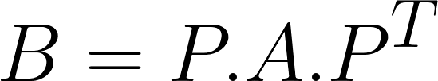
Special Cases :Eigenvalues with algebraic multiplicity 1
Permutation matrix as an operator :
:The rows of A get permuted as in P
: The columns of A get permuted as in P
A, B are adjacency matrices of Isomorphic graphs. Then,
for some P

Slide 23
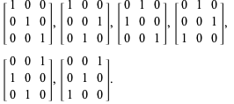
Special Cases :Eigenvalues with algebraic multiplicity 1
Permutation Matrices :
A Permutation matrix P is a matrix obtained by interchanging the rows of an Identity Matrix
Set of all Permutation matrices of order n form a group
under matrix multiplication operation

Slide 24
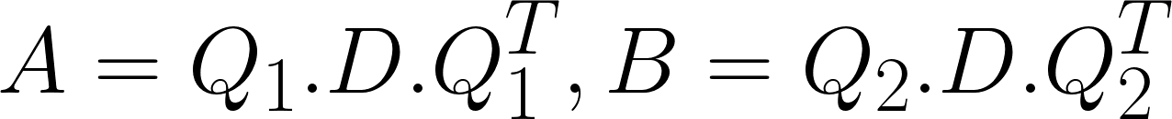


Special Cases :Eigenvalues with algebraic multiplicity 1
It can be proved that A and B have same eigenvalues
Diagonalisation :
If algebraic multiplicity of all eigenvalues is 1, it can be shown that
where S is a diagonal matrix with +1 or -1 entries
This idea can be used to design an algorithm for this special case

Slide 25
Special Cases :Eigenvalues with algebraic multiplicity 1
In case the 1-norms of each eigenvector are distinct, then a canonical labelling of vertices can be provided, using the 1-norms
The nodes representing columns with same 1-norm get the same label
After the canonical labelling is obtained,the isomorphism is easy to see
If the sign of the eigenvector(the element in S) can be chosen canonically in some way, it can also be used if the 1-norms are not distinct

Slide 26
PQ Trees
A Tree data structure to represent a subset of Permutations(ordering of elements of a set) of all Possible permutations
Each leaf represents the elements that need to be ordered
Non leaves are classified as P and Q nodes
A transformation on P node : Its children can be arranged in any order
A transformation on Q node : Its children can only be arranged in reverse order
An ordering is the reading the leaf elements from left to right

Slide 27
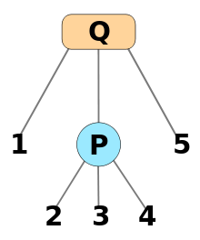
PQ Trees
The orderings that can be represented by this PQ tree:
1,2,3,4,5 5,2,3,4,1 1,2,4,3,5
5,2,4,3,1 1,4,3,2,5 5,4,3,2,1
1,4,2,3,5 5,4,2,3,1 1,3,2,4,5
5,3,2,4,1 1,3,4,2,5 5,3,4,2,1
Two PQ trees T1 and T2 are equivalent if they represent same set of orderings
The set of orderings represented by a PQ tree T is denoted by consistent(T).

Slide 28
Fulkerson and Gross Theorem
Statement : G is an interval graph if and only if there exists a linear ordering of its cliques such that for each vertex v , the elements of C(v) appear consecutively within the ordering , where C(v) is the set of all cliques in which v is a member
How to identify if a graph is interval graph based on this theorem???
Take S as the set of orderings of the cliques. For each v, delete those orderings where C(v) don’t appear consecutively. If at the end, S is non empty, it is interval graphs. This can be implemented efficiently using PQ trees.

Slide 29
Special Cases : Interval Graph
Linear time algorithm for deciding interval graphs are isomorphic-O(n+e)
Implemented using data structure call PQ-Tree
A proper PQ-Tree can be made for an interval graph in O(n+e),
A PQ-Tree is an ordered tree whose non-terminal tree nodes fall into two classes P or Q

Slide 30
Special Cases : Interval Graph
Given interval graphs G and G',
First construct the trees T(G) and T(G")
Algorithms given to obtain corresponding proper canonical labeled PQ-trees T and T'
Determine whether these are L-identical,can be done in linear time by a preorder scan of trees

Slide 31
Special Cases : Planar Graph
Test if G1 and G2 are planar graphs
Decompose G1 and G2 into biconnected components and construct the tree of biconnected components
Decompose each biconnected component into its triconnected components and construct the SPQR-tree.
Construct unique code for every SPQR-tree and in bottom-up fashion construct unique code for the biconnected tree
If Code(G1) = Code(G2) G1 is isomorphic to G2

Slide 32
Practical graph isomorphism
Nauty is a set of procedures for determining the automorphism group of a vertex-coloured graph, and for testing graphs for isomorphism.
Traces is an alternative program for these operations.
nauty and Traces are written in a highly portable subset of the language C
Isomorphism is done by canonical labelling
To handle this situation, vertices in nauty and Traces can be coloured

Slide 33
Practical graph isomorphism
nauty and Traces consider the colours to come in some order; i.e., there is a 1st colour, a 2nd colour, etc..The new vertex labels are in order of colour.
The vertices of the first colour are labelled first, of the second colour next, and so on.
This rule means that the canonical labelling can be used to determine if two coloured graphs are isomorphic
Traces is currently one of the leader on the majority of difficult graph classes, while nauty is still preferred for mass testing of small graphs

Slide 34
Applications
Layout Vs Schematic : Automation verification software that determines if a circuit layout corresponds to an intended design scheme
Computer Vision : Identification of an unknown image by comparing with a known image

Slide 35
Applications
Linguistics : Identifying similarities in languages having a common ancestor
Compound Identification :
Used to find a compound in chemical database
Atoms as nodes and bonds as edges
Many other areas like biometrics, genome editing, verification etc.

Slide 36

Q & A

Slide 37
THANK YOU

